Slide 1

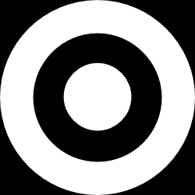

Bank Customer Churn Prediction
Pham Hong Thuy - 611121308

Slide 2

Table Of Content
01
Data set description and preparation
02
Decision tree classifier
03
Support vector machine – SVM
04
Undersampling technique
05
Oversampling technique
06
Discussion and comments

Slide 3

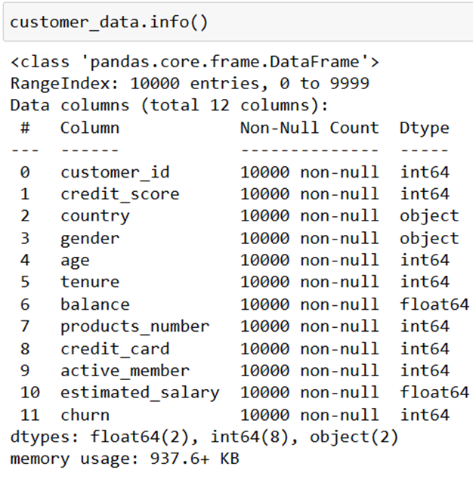
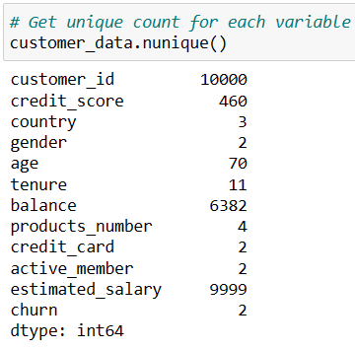
Dataset description and preparation
The dataset for prediction model contains 10000 rows and 12 following columns in which the “churn” column is the target label for prediction.

Slide 4

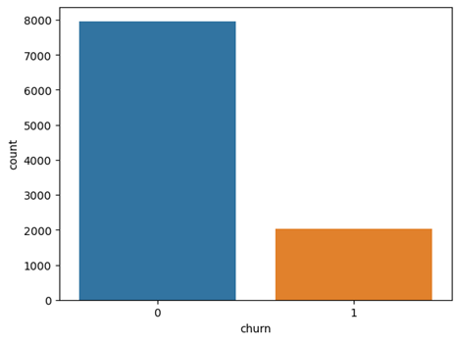
About the dataset
The “customer_id” columns would be separated from the dataset, because it has 10000 unique values, which indicate that it is specific for each customer and do not contribute to the prediction process.
Examining the “churn” features alone, it is binary attribute, with the value “1” means that the client has left the bank and the value “0” imply that the client has not. It contains 10,000 records of which 7,963 (79.63%) are non-churners and 2,037 (20.37%) are churners.
A balanced dataset usually contains an equal or or almost equal number of samples of predicted class. Therefore, the dataset is highly unbalanced in terms of the proportion of churners and non-churners.

Slide 5
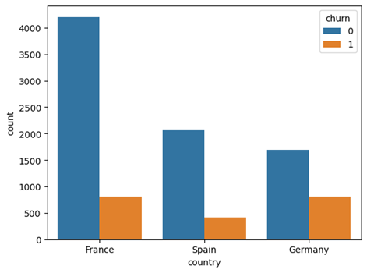
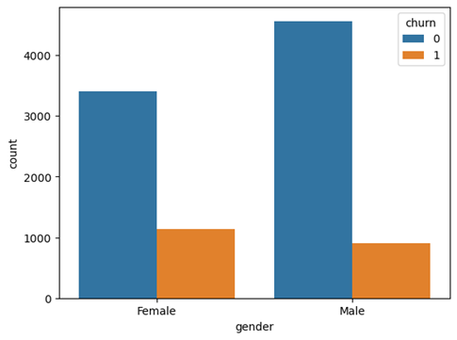
Data Visualization

Slide 6
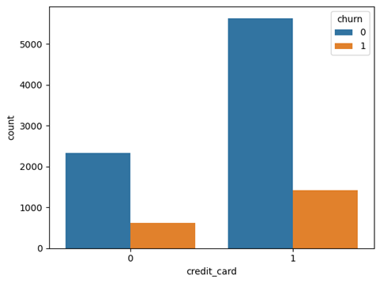
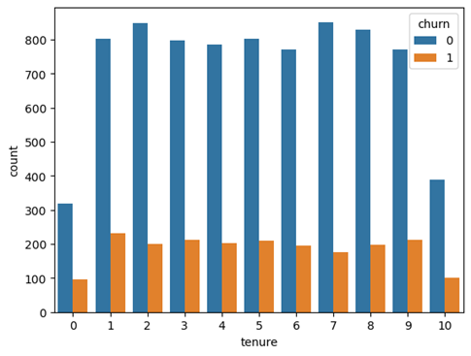
Data Visualization

Slide 7
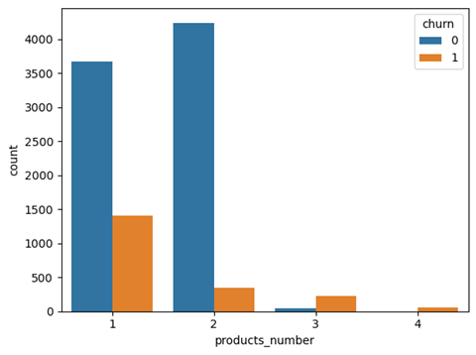
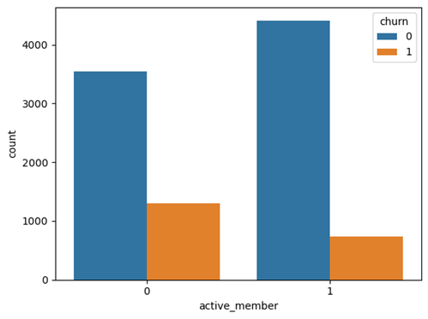
Data Visualization

Slide 8
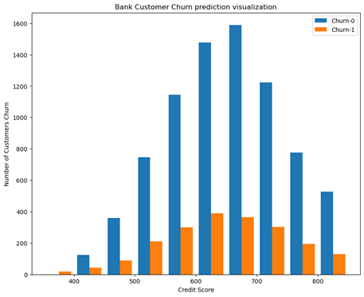
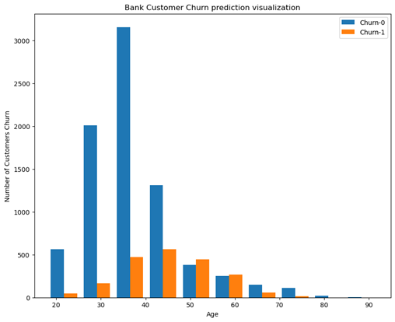
Data Visualization

Slide 9
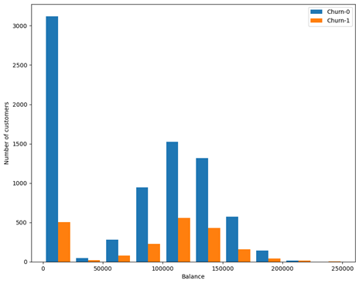
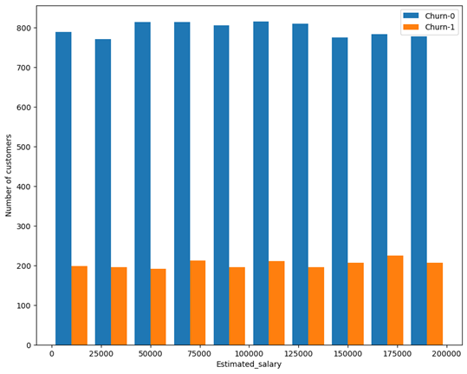
Data Visualization

Slide 10
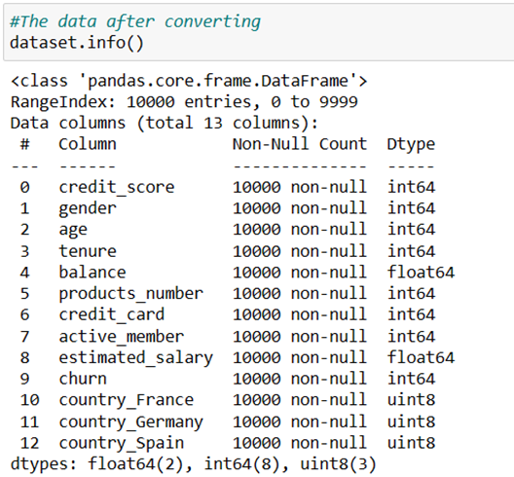
Data preprocessing
The data would be preprocessed before introducing it to the proposed classifiers. The nominal attributes which are “gender” and “country” need to be converted. The “gender” feature has only two unique data point therefore it would be converted into 0 and 1, with “Female” equal to “0” and “Male” equal to “1”.
With the “country” columns, it has 3 three unique data points, therefore it will be split into three different columns which are “country_France”, “country_Germany”, and “country_Spain”. The value would be change to “1” if the customer from that country and “0” in other columns.

Slide 11

Decision Tree Classifier
The decision tree classifier is defined as a non-parametric supervised learning algorithm, which is utilized for both classification and regression tasks. It has a hierarchical, tree structure, which consists of a root node, branches, internal nodes and leaf nodes.
A decision tree starts with a root node, which does not have any incoming branches. The outgoing branches from the root node then feed into the internal nodes, also known as decision nodes. Based on the available features, both node types conduct evaluations to form homogenous subsets, which are denoted by leaf nodes, or terminal nodes. The leaf nodes represent all the possible outcomes within the dataset. [1]

Slide 12
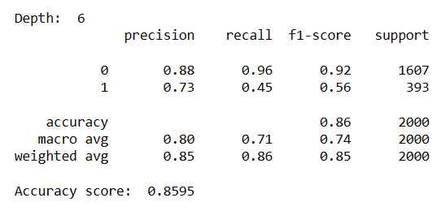
Decision Tree Classifier
The conduct of decision tree for the bank customer dataset would be as follow:
All feature values would be separated as data set X, and “churn” as target label set y.
The train_test_split module would split the data set into a training set and a test set, in this case the training set would be 80% of the dataset and the test set would be 20%.
Use Gini as the standard to build a decision tree model, and set the depth between 3 and 7, and observe when the depth is better for the model. The Gini measure is the default parameter of scikit-learn library
The highest accuracy score is 0.8595 when the depth is 6. However, as mentioned before, because the dataset is highly unbalanced, the recall, precision rate and f1 score is not highly ideal. The most important feature of the dataset is “age”, which is consistent with the previous analyse from visualization data.

Slide 13
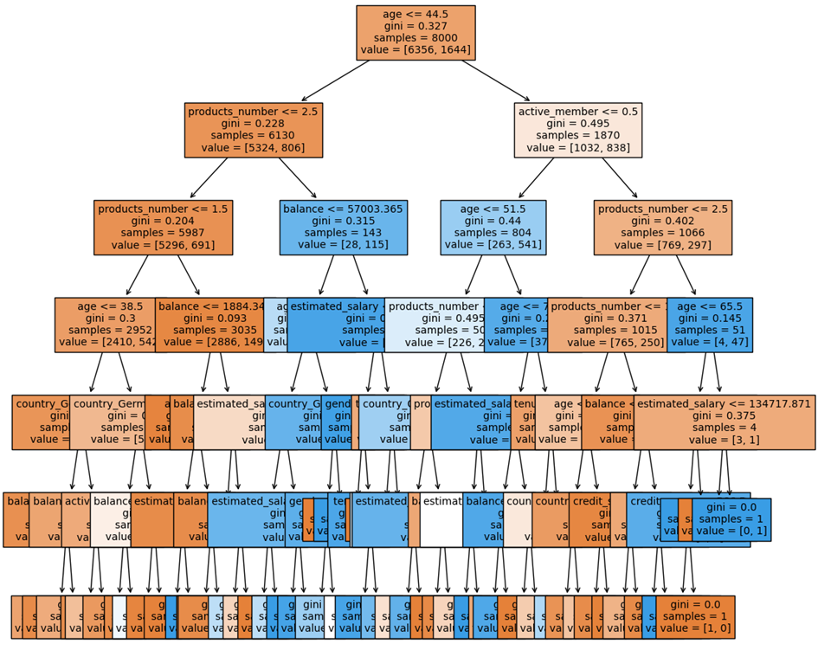
Decision Tree Classifier

Slide 14
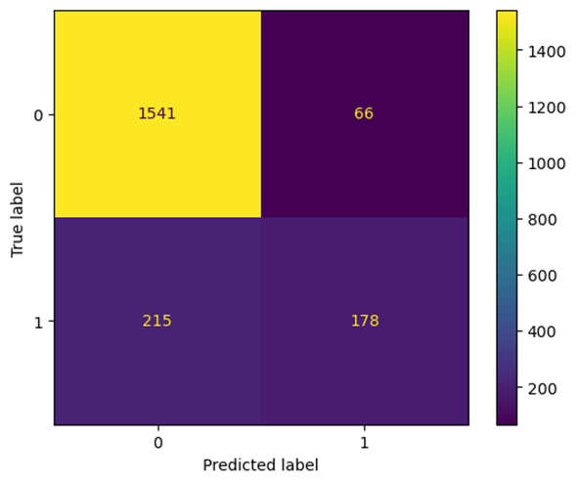
Decision Tree Classifier
Despite the high accuracy score, the result from the confusion matrix below is not saticfactory. There are 1,541 values of “0” is correctly classified and only 215 values is misclassified. Unfortunately, there are only 178 values of “1” is correctly classified, which account for a small amount of testing data.

Slide 15

Support vector machine – SVM
A support vector machine is a supervised learning algorithm that sorts data into two categories.
It is trained with a series of data already classified into two categories, building the model as it is initially trained.
The task of an SVM algorithm is to determine which category a new data point belongs in.
This makes SVM a kind of non-binary linear classifier. [2]

Slide 16
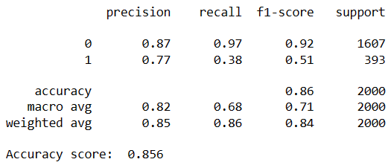
Support vector machine – SVM
One of the key hyperparameters of SVM model is C. In brief, the C value is used to control the width of the vector margin, the higher the C values, the model accuracy increases.
The GridSearchCV would be applied to find the best value of C parameters. The best value of C found in this bank customer prediction equal to 1.
After finding the best C value, the features of training data, would be standardized to apply the SVM model.
The accuracy score is approximately equal to the result from the decision tree. As mentioned before, because the data is unbalanced, the recall and f1 score is not ideal.

Slide 17
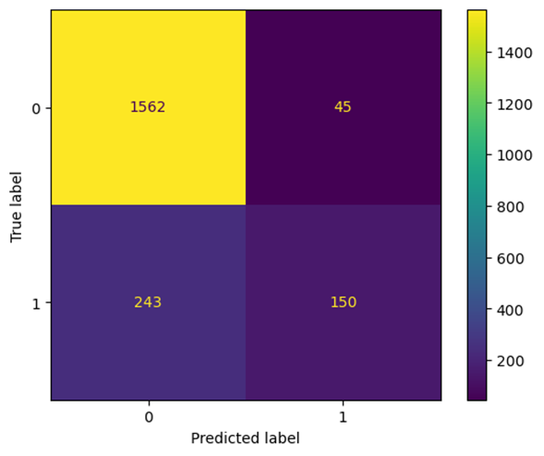
Support vector machine – SVM
The unbalance is much more clearer in the confusion matrix. It also demonstrate large number of value “0” is classified correctly while only 150 values of “1” is classified correctly out 2,000 testing data points.
In some paper, there are many techniques to solve the unbalanced data issue. This experiment would apply two techniques which are undersampling and oversampling, and then evaluate the models with 10-fold cross-validation to find out which technique and model give the best result.

Slide 18
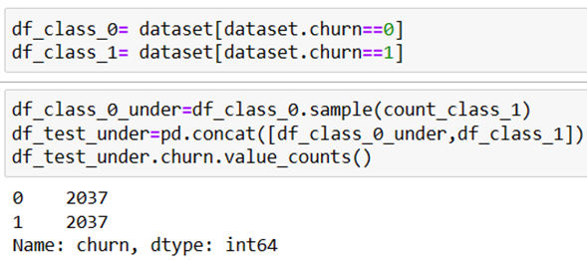
Undersampling Technique
The undersampling technique would take all the classes to the equal amount as the minority class. In this case, the undersampling dataset would reduce the amount of values “0” to the same amount of values “1” of predicted label.

Slide 19
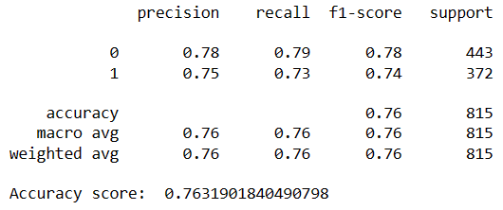
Decision Tree Classifier
Undersampled Dataset
The Accuracy Report

Slide 20
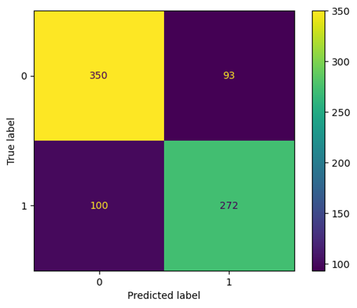
Decision Tree Classifier
Undersampled Dataset

Slide 21
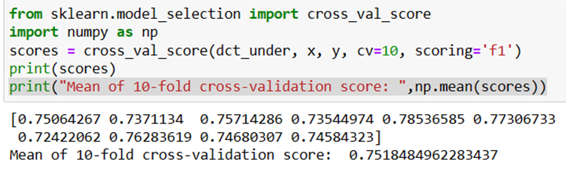
Decision Tree Classifier
Undersampled Dataset
The 10-fold cross-validation for model evaluation also has a consistent result with mostly over 70%.

Slide 22
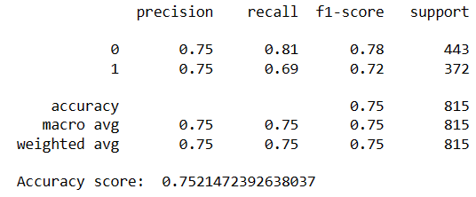
SVM - Undersampled Dataset
The Accuracy Report

Slide 23
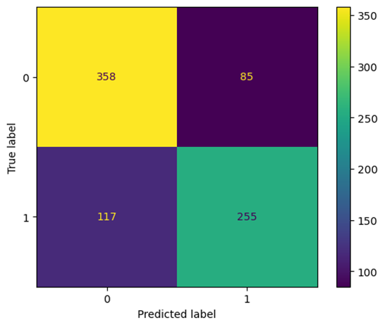
SVM - Undersampled Dataset

Slide 24
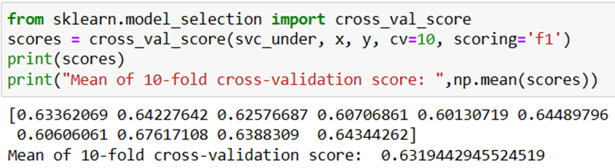
SVM - Undersampled Dataset
Compared with the decision tree classifier with the results be mostly over 70%, SVM seems to have poorer performance.

Slide 25
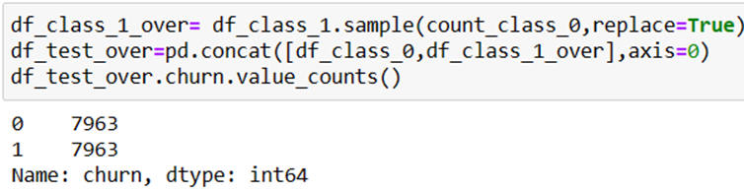
Oversampling technique
The oversampling techniques in some ways is similar to the undersampling techniques, which means that the dataset will have equal amount of churners and non-churners. However, the amount of churners would be duplicate randomly to equal the amount of non-churners. The dataset would look like below.

Slide 26
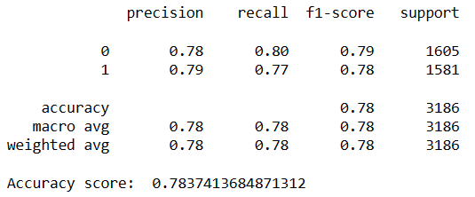
Decision Tree Classifier
Oversampled Dataset
The Accuracy Report

Slide 27
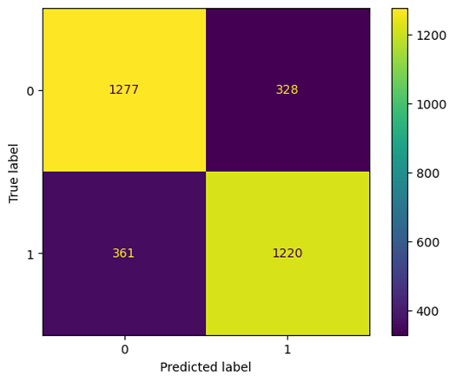
Decision Tree Classifier
Oversampled Dataset

Slide 28
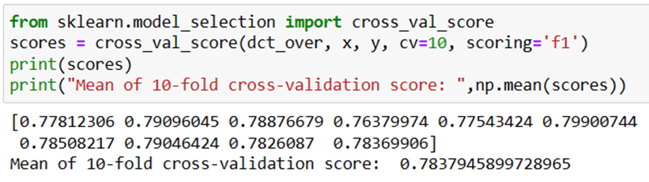
Decision Tree Classifier
Oversampled Dataset
The mean of 10-fold cross-validation scores from decision tree with undersampled data is approximately over 75%, which means that decision tree with oversampled dataset has slightly better performance with over 78%

Slide 29
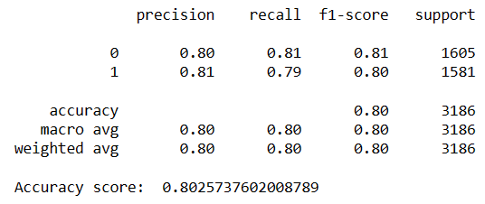
SVM - Oversampled Dataset
The Accuracy Report

Slide 30

SVM - Oversampled Dataset

Slide 31
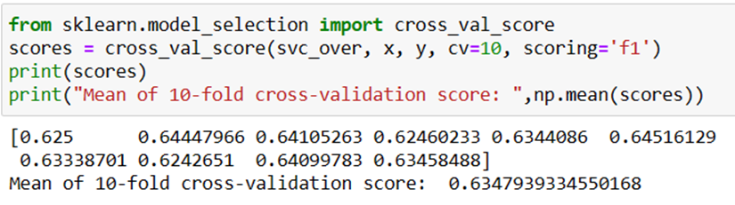
SVM - Oversampled Dataset
The mean of 10-fold cross-validation scores from both undersampled and oversampled dataset is not clearly different. However, compared with the results of decision tree which are approximately 75% and 78%, respectively, SVM model obviously has less ideal performance

Slide 32
Discussion and comments
The accuracy over 0.5 could be considered a successful model. However, with highly unbalanced data, the accuracy score is not enough, it should be combined with the F1 score, which allows combining both precisions and recall into a single measure.
The majority of the datset is labeled “0”, which accounted for nearly 80% customers who retained at the bank and below 20% of customers left the bank.
In undersampling, this includes removing many random records from the majority class, which could lead to lack of information. Meanwhile random oversampling duplicates the minority can cause overfitting for some models.
For the SVM model combined with undersampling and oversampling data, it could be due to the weaknesses of resampling methods that cause conflict in the accuracy report and poor performance from model evaluation with 10-fold cross-validation. SVM model has an disadvantage that is it does not suffer the condition of overfitting.
While one of the advantages of decision tree is data exploration, which means that it allows the exploration of the changing variables. [4] Therefore, results from model evaluation of decision tree is much more ideal than SVM.

Slide 33

Thanks for your time and consideration
Pham Hong Thuy

